Slide 1
ScienceDirect
Make the most of your access to ScienceDirect

Slide 2
ScienceDirect Training Deck
We’re here to help you make the most of your access to ScienceDirect.
ScienceDirect
ScienceDirect offers researchers the latest in discovery technology to ensure that you can quickly and easily find the information you need, as well as stay up to date on the latest developments in, and related, to your field.
Elsevier’s leading platform of peer-reviewed scholarly literature.
  Create a User Account
  Search
  Get Recommendations
  Set Up Alerts
  Key Features
  Find Help and Support
  Provide Feedback
ScienceDirect combines authoritative, full-text scientific, technical and health publications with smart, intuitive functionality so that users can stay informed in their fields and can work more effectively and efficiently.

Slide 3
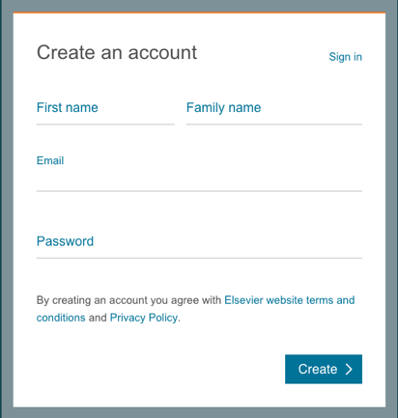



1. Create a User Account
Your account unlocks a range of customization and research alert features that have been designed to support your research goals (and its easy and free!)
With a few personal details, an account provides you with the ability to:
Set up alerts for search queries, journals and book-series
Receive recommendations that are personal to your search history and signed-in activity
Access ScienceDirect remotely outside of your institutions IP range
Create an account now

Slide 4


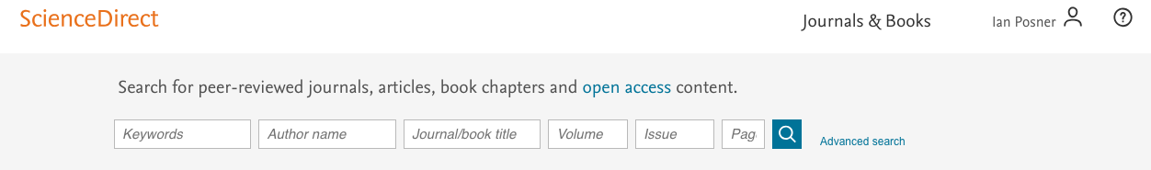
2. Search
Search ScienceDirect with precision and ease
ScienceDirect offers researchers 2 different search techniques:
Search broadly and then filter
Use Advanced Search to launch a narrow, pre-selective query
or
Use our search bar or “Quick Search” to search broadly

Slide 5
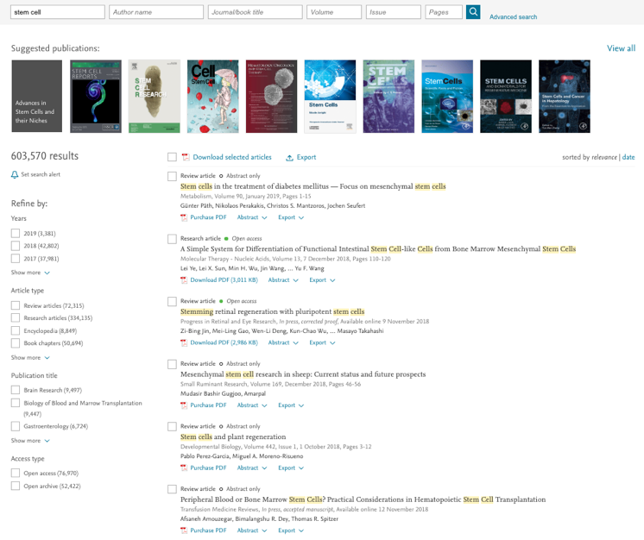
2. Search
And subsequently filter down the results
By Year
By Article Type
By Publication Type
By Access Type

Slide 6
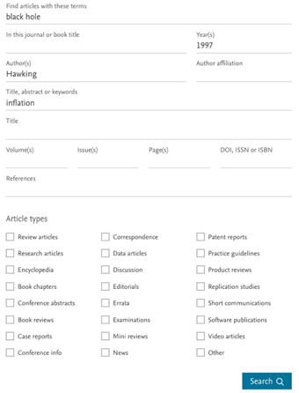

2. Search
Our Advanced Search helps you narrow your focus from the start
Our Advanced Search supports
Boolean operators including:
AND, OR, AND NOT, NOT (-),
Nested clauses using parenthesis, for example:
(((“heart attack” OR “myocardial infarction” OR cardiac) AND diabetes) OR ischemia)

Slide 7
2. Search
You can combine terms using up to 8 Boolean operators AND, OR and NOT. Grouping terms using parentheses is also possible, as well as creating multi-level nested clauses. For example: (“black hole” OR radiation) AND gravity.
Our Advanced Search offers you the possible to exclude terms by using the minus-hyphen operator. For example, to find articles related to depression but not economic depression, search for: depression-economics.
To find all articles authored by Heisenberg but not by Sommerfeld, enter the following in the ‘Authors’ search box: Heisenberg-Sommerfeld.

Slide 8

3. Get Recommendation
Set up alerts for the latest research — by topic, journal or book series
ScienceDirect Recommendations is a service that sends registered, signed in visitors a weekly list of recommended research content based on your previous search history and signed-in activity.
All you need is a registered account and to remember to stay signed in when you search on ScienceDirect. Our recommender engine does the rest by connecting you to other research (new and existing) that ScienceDirect has determined is relevant to your interests.

Slide 9
4. Set Up Alerts
Set up alerts for the latest research — by journal, book series or search queries
Managing your alerts
Alerts differ from personal recommendations in that you are only alerted when NEW research that meets YOUR criteria becomes available.
Recommendations, by contrast, include all research – regardless of publication date, that met the relevancy criteria determined by our recommender engine.

Slide 10
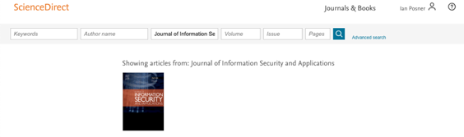
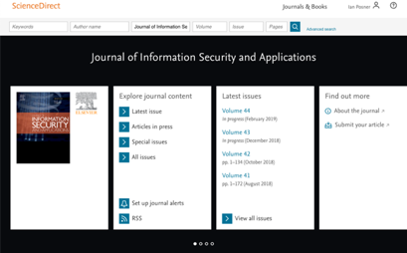
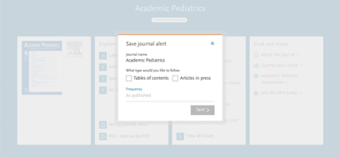
4. Set Up Alerts
Saving alerts by book or journal series
For more info on how to set up and manage alerts, visit our tutorial here.

Slide 11
4. Set Up Alerts
Set up alerts to notify you of new articles that match your search request

Slide 12



5. Key Features
1
2
ScienceDirect Topics helps researchers uncover critical and contextual information within their workflow
Each topic page provides authoritative introductory overviews to help researchers, academics and students understand and interpret scientific literature
ScienceDirect Topics enables quick onboarding to novel subject areas during interdisciplinary research and offers an easy, interactive tool for students learning a new concept or understanding a journal article
3
1
Short definition
2
Related Terms
3
Excerpts from relevant book content

Slide 13


5. Key Features
ScienceDirect Topics uniquely applies cutting-edge technologies to content within the research workflow
Topic pages link narrow, specialized knowledge of journal content, which can be difficult to understand for researchers new to the specialized field, with both the quick overview of the journal content’s topic and with the more general Book content.
Data Science Technologies
Data-mining
Taxonomy building
Algorithmic information extraction
Relevancy ranking
Quality confirmation
Topic Pages
Book Content

Slide 14



5. Key Features
Looking for an easy way to store references and collaborate with others?
Manage, organize and connect around books and journals with Mendeley, seamlessly embedded in ScienceDirect
Mendeley is a reference manager allowing you to manage, read, share, annotate and cite your research papers...
...and an academic social network with 3 million users to connect like-minded researchers & discover research trends and statistics…
…forming a crowdsourced database with a unique layer of social research information and an Open API
Quickly export your Book chapters and journal articles into Mendeley from ScienceDirect*
*See OnlineBooksConnect article for more information:
https://onlinebooksconnect.elsevier.com/articles/how-to-export-book-chapters-and-reference-to-mendeley

Slide 15
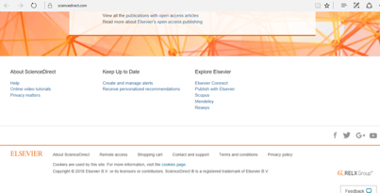
5. Key Features
Access ScienceDirect anytime, anywhere
Whether you're on your laptop, tablet, or phone, at home or on the road, on campus or off, you can keep your research going by registering today for remote access to ScienceDirect.
v
Remember, the next time you're off campus you can always (detailed instructions here):
Click on "Remote access" in the
footer on any ScienceDirect page.
Follow the instructions to enter your institutional email address (e.g., john.smith@nyu.edu) and select your organization from the drop-down menu.
We'll send you an email; click on the "Activate my remote access now" link and your remote access is all set. (If you are not registered in ScienceDirect, the registration page displays)

Slide 16

5. Key Features
The recently redesigned Browse page and Journal and Books homepages features make browsing through your favorite content easier
v

Slide 17

5. Key Features
ScienceDirect APIs support large-scale data mining for government and academic research institutions
Use ScienceDirect APIs to retrieve and integrate full-text content from publications on ScienceDirect into your own website or applications.
Anyone can obtain an API key and use our APIs free of charge, provided that our policies are honored.
ScienceDirect subscribers are granted full access to ScienceDirect APIs. If you do not have a ScienceDirect subscription, you can still use our APIs; however, you will have limited access to basic metadata and basic search functionality, yet full access to all open access content.
Learn more about the key settings data available to you and start developing today.

Slide 18
6. Find Help & Support
While we strive to make ScienceDirect easy and intuitive to use, you might have questions. Our Customer Support Center has answers to your frequently asked questions, information on the latest product updates, video tutorials and other how-to guides.
Visit the ScienceDirect Support Center
You can also learn about the latest product updates
You can access the Customer Support Hub, by clicking the
“?” Button in the upper right corner of ScienceDirect pages.

Slide 19
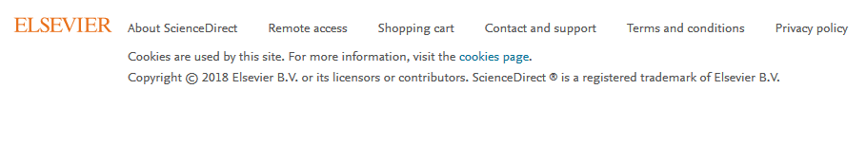

6. Find Help & Support
Contact Us
While we strive to make ScienceDirect easy and intuitive to use, sometimes help is required. Our customer support team is here to help and you can contact us various ways.
You can contact us by scrolling down to the bottom of all our ScienceDirect pages to find a “Contact and support” option.

Slide 20
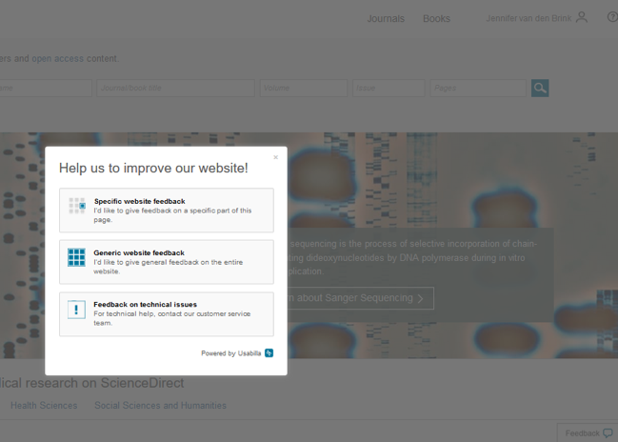

7. Provide Feedback
Did you know? We love YOUR feedback… which helps us to continually improve ScienceDirect.

Slide 21
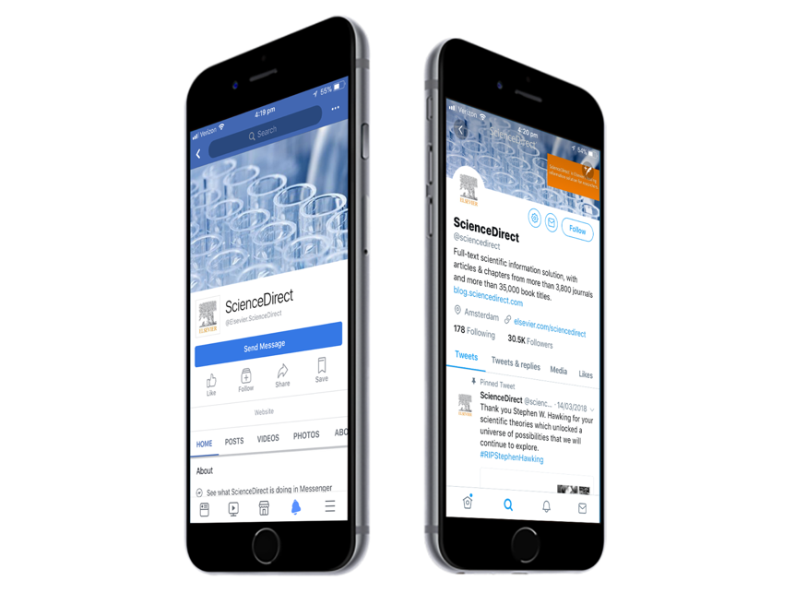


Let’s stay in touch
Facebook
/Elsevier.ScienceDirect
Twitter
@ScienceDirect

